Slide 1
Chapter 2: BJT and its applications
Module 2 : Transistor Biasing
Reference: Robert L. Boylestad, Louis Nashelsky, Electronic Devices & Circuits Theory, 11th Edition, PHI, 2012

Slide 2
Objectives
Discuss the concept of biasing of the transistor.
Analyse the fixed and self bias circuits.
Identify the circuit parameters that effect Q point.

Slide 3
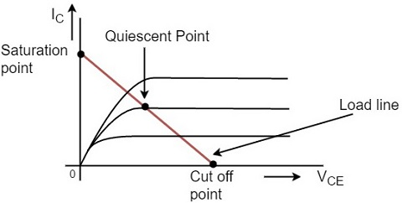
Operating Point / Quiescent Point
For the BJT to operate effectively , it has to be properly biased.
Set a certain value of I and V in the BJT→ Biasing
These values correspond to a point on the BJT output characteristics

Slide 4
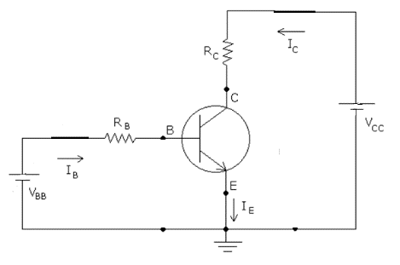
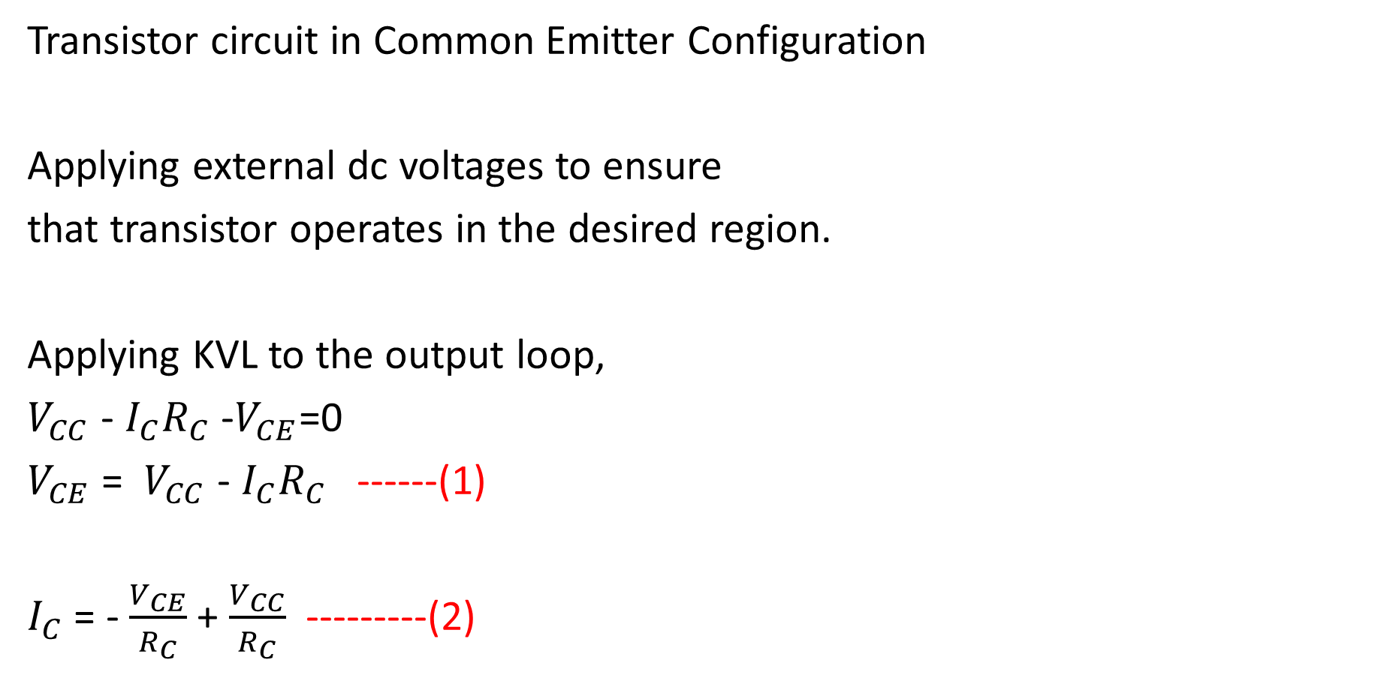
Transistor circuit in Common Emitter Configuration
Applying external dc voltages to ensure
that transistor operates in the desired region.
Applying KVL to the output loop,
$V_{CC}$ - $I_{C}R_{C}$ -$V_{CE}$=0
$V_{CE}$ = $V_{CC}$ - $I_{C}R_{C}$ ------(1)
$I_{C}$ = - $\frac{V_{CE}}{R_{C}}$ + $\frac{V_{CC}}{R_{C}}$ ---------(2)

Slide 5
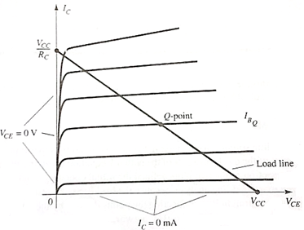

From equation (1), when $I_{C}$=0,
$V_{CE}$ = $V_{CC}$ -------------(3)
From equation (2) when $V_{CE}$=0,
$I_{C}$ = $\frac{V_{CC}}{R_{C}}$ -------------(4)
Equation (3) and (4) form the
extremities of $I_{C}$ and $V_{CE}$
Line joining these two points → DC Load Line

Slide 6
The point where DC load line cuts the output characteristics is called
Quiescent Point (Q Point) / Operating point
Depending on the requirement, Q point can be moved to Saturation, Active or Cut-off region
To set the Q Point, biasing is necessary
Note: When no biasing is applied, Q point is at the origin

Slide 8
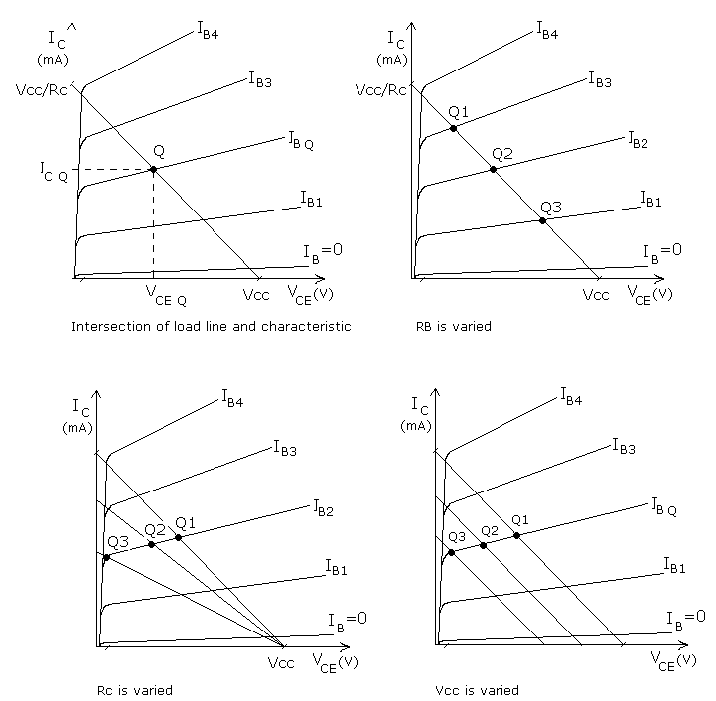
Variation in load line with circuit parameters

Slide 9
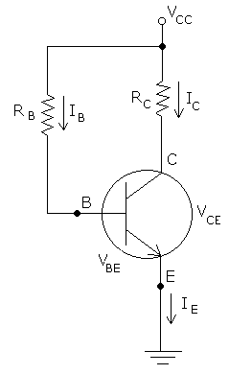
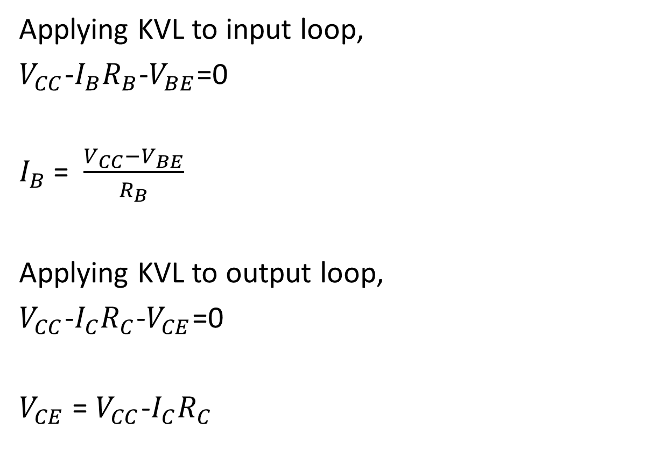
Fixed Bias / Base Current Bias
Applying KVL to input loop,
$V_{CC}$-$I_{B}R_{B}$-$V_{BE}$=0
$I_{B}$ = $\frac{V_{CC}−V_{BE}}{R_{B}}$
Applying KVL to output loop,
$V_{CC}$-$I_{C}R_{C}$-$V_{CE}$=0
$V_{CE}$ = $V_{CC}$-$I_{C}R_{C}$

Slide 10
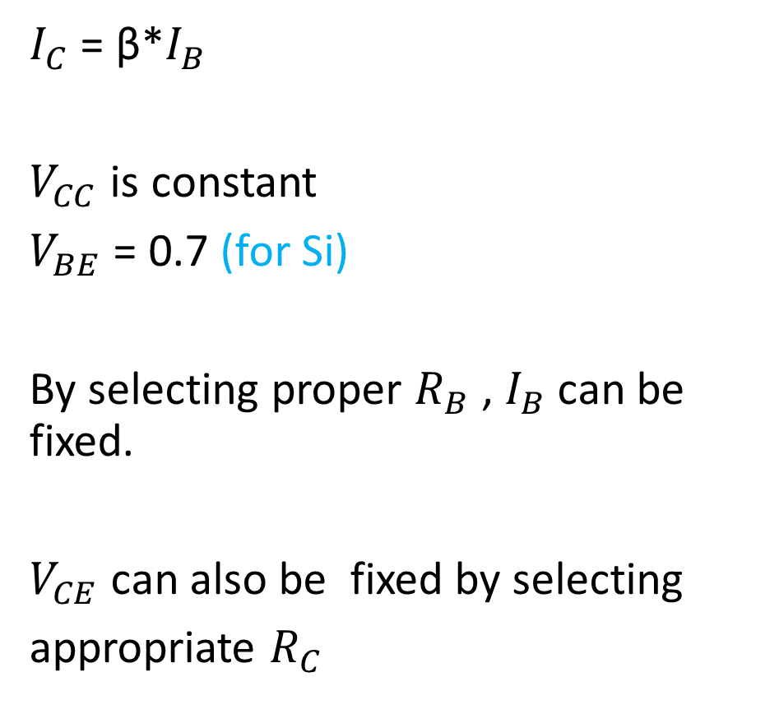
$I_{C}$ = β*$I_{B}$
$V_{CC}$ is constant
$V_{BE}$ = 0.7 (for Si)
By selecting proper $R_{B}$ , $I_{B}$ can be fixed.
$V_{CE}$ can also be fixed by selecting
appropriate $R_{C}$

Slide 11
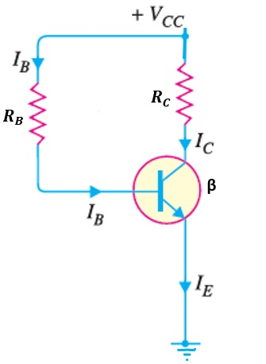
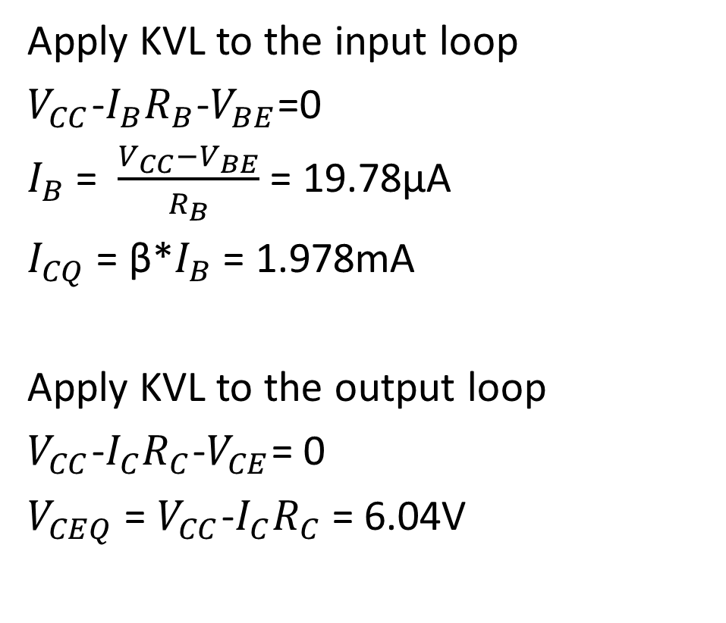
Q1. For the circuit shown below, draw the DC load line and mark the Q point/ operating point.(Si transistor used)
Apply KVL to the input loop
$V_{CC}$-$I_{B}R_{B}$-$V_{BE}$=0
$I_{B}$ = $\frac{V_{CC}−V_{BE}}{R_{B}}$ = 19.78µA
$I_{CQ}$ = β*$I_{B}$ = 1.978mA
Apply KVL to the output loop
$V_{CC}$-$I_{C}R_{C}$-$V_{CE}$= 0
$V_{CEQ}$ = $V_{CC}$-$I_{C}R_{C}$ = 6.04V
10V
2kΩ
470kΩ
100

Slide 12
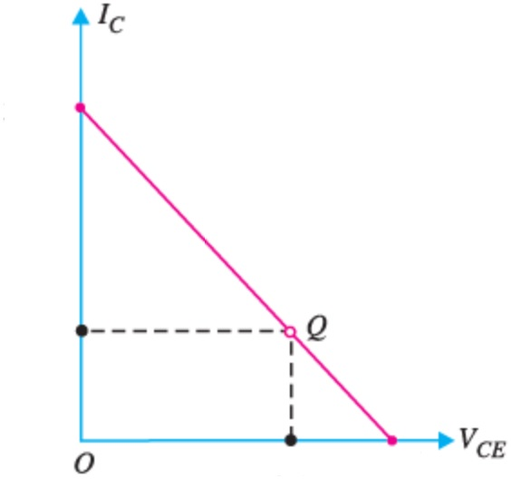



To draw DC Load Line
$V_{CEmax}$ = $V_{CC}$ =10V
$I_{Cmax}$ = $\frac{V_{CC}}{R_{C}}$ = 5mA
$$I_{Cmax}$$
5mA
1.978mA
6.04V
$$V_{CEmax}$$
10V

Slide 13
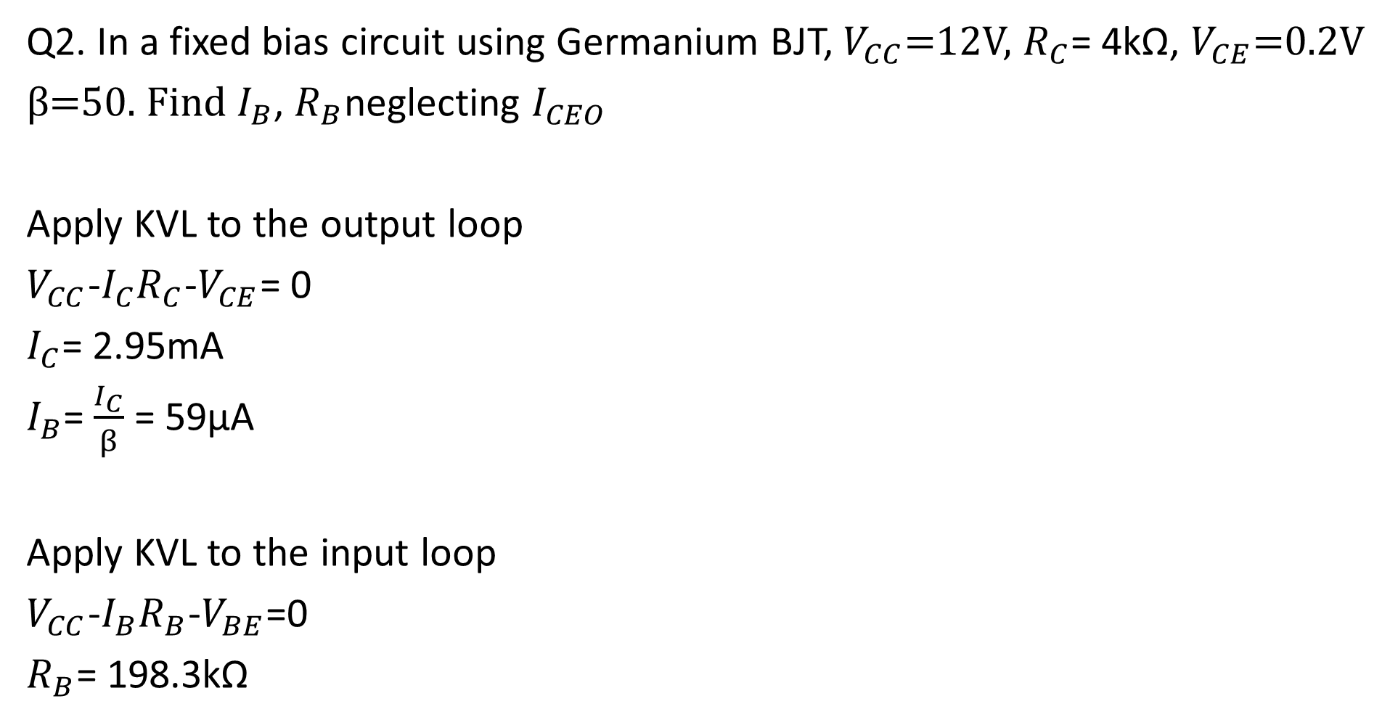
Q2. In a fixed bias circuit using Germanium BJT, $V_{CC}$=12V, $R_{C}$= 4kΩ, $V_{CE}$=0.2V
β=50. Find $I_{B}$, $R_{B}$neglecting $I_{CEO}$
Apply KVL to the output loop
$V_{CC}$-$I_{C}R_{C}$-$V_{CE}$= 0
$I_{C}$= 2.95mA
$I_{B}$= $\frac{I_{C}}{β}$ = 59µA
Apply KVL to the input loop
$V_{CC}$-$I_{B}R_{B}$-$V_{BE}$=0
$R_{B}$= 198.3kΩ

Slide 14
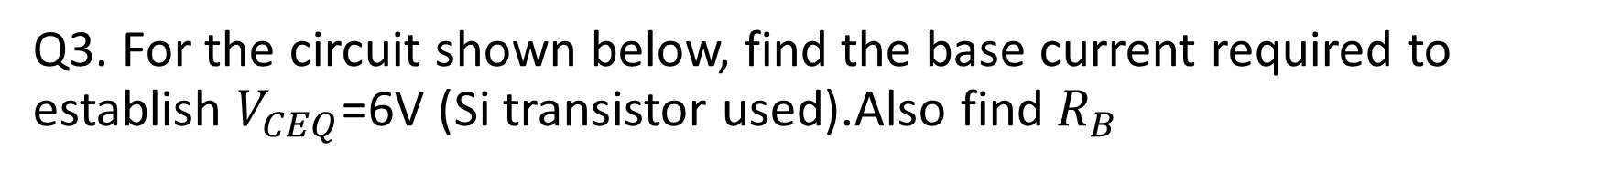
Q3. For the circuit shown below, find the base current required to establish $V_{CEQ}$=6V (Si transistor used).Also find $R_{B}$
12V
2.2kΩ
120

Slide 15
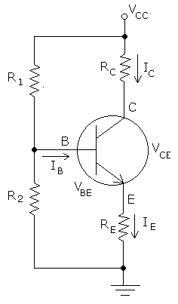
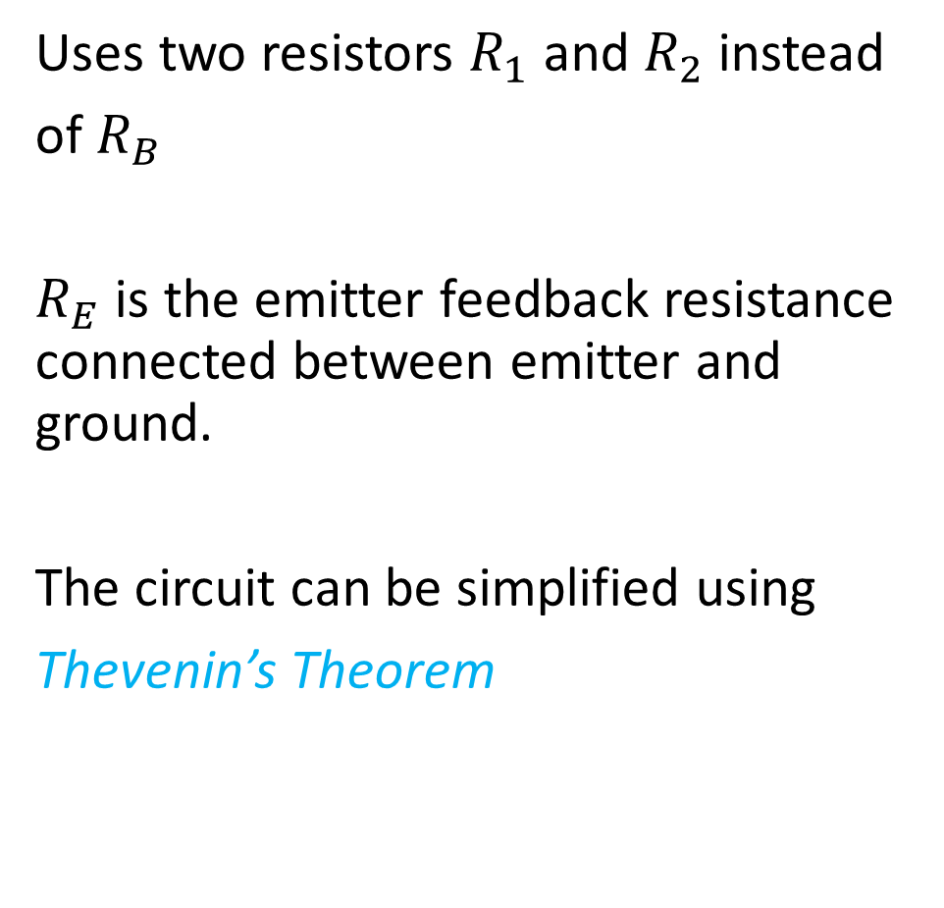
Self Bias / Voltage Divider Bias
Uses two resistors $R_{1}$ and $R_{2}$ instead
of $R_{B}$
$R_{E}$ is the emitter feedback resistance connected between emitter and ground.
The circuit can be simplified using
Thevenin’s Theorem

Slide 17
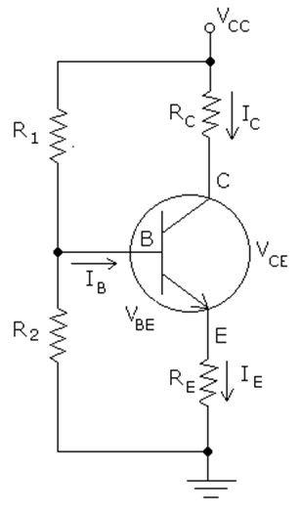
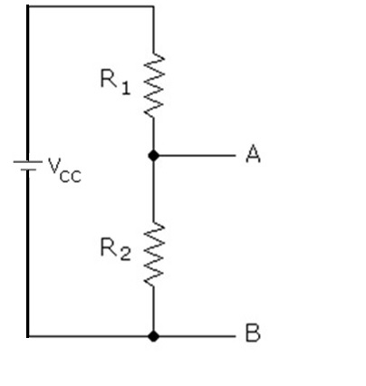
A
B

Slide 18
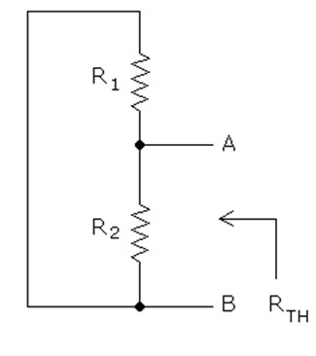
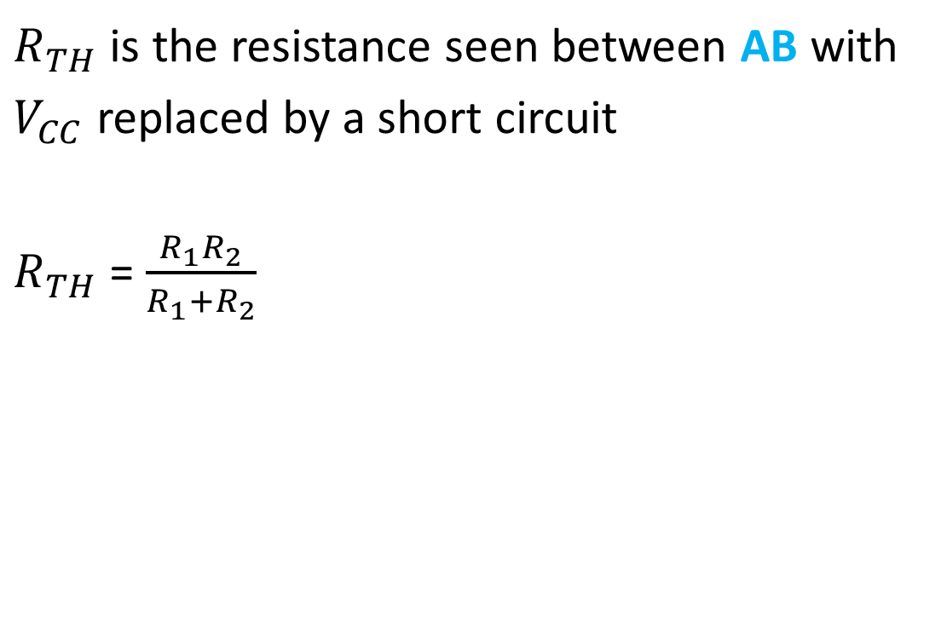
Thevenin’s Resistance
$R_{TH}$ is the resistance seen between AB with
$V_{CC}$ replaced by a short circuit
$R_{TH}$ = $\frac{R_{1}R_{2}}{R_{1}+R_{2}}$

Slide 19
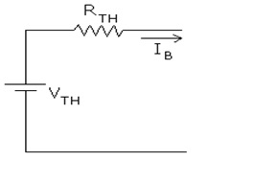

Thevenin’s Voltage
$V_{TH}$is the open circuit voltage between AB
$V_{TH}$ = $\frac{V_{CC}∗R_{2}}{R_{1}+R_{2}}$
A
B

Slide 20
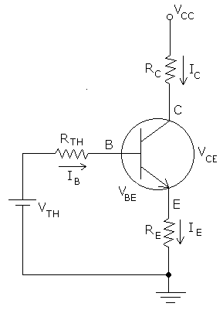

Self bias circuit with input loop replaced by Thevenin’s equivalent circuit
Apply KVL to the input loop,
$V_{TH}$ - $I_{B}R_{TH}$ - $V_{BE}$ - $I_{E}R_{E}$ = 0
Substitute $I_{E}$ = $\left(β+1\right)I_{B}$
$I_{B}$= $\frac{V_{TH}−V_{BE}}{R_{TH} + (β+1)R_{E}}$

Slide 21

Since β+1 ≃ $β$ and β$R_{E}$>> $R_{TH}$
$I_{B}$= $\frac{V_{TH}−V_{BE}}{βR_{E}}$
Collector current $I_{C}$= β*$I_{B}$
$I_{C}$= $\frac{V_{TH}−V_{BE}}{R_{E}}$
$I_{C}$ is now independent of β , where β is a temperature dependent factor

Slide 22

Applying KVL to the output loop,
$V_{CC}$-$I_{C}R_{C}$-$V_{CE}$-$I_{E}R_{E}$=0
$V_{CE}$ = $V_{CC}$-$I_{C}R_{C}$-$I_{E}R_{E}$

Slide 25
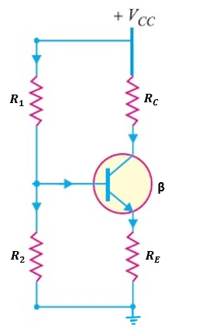

Q4. For the self bias circuit shown below, draw the DC load line and mark the Q point/ operating point.(Si transistor used)
$R_{E}$= 200Ω , $R_{1}$=10$R_{2}$= 10kΩ , $R_{c}$=2kΩ, β=200 , $V_{CC}$=15V

Slide 26

$R_{TH}$ = $\frac{R_{1}R_{2}}{R_{1}+R_{2}}$ = 0.909kΩ
$V_{TH}$ = $\frac{V_{CC}∗R_{2}}{R_{1}+R_{2}}$ = 1.364V
Apply KVL to the input loop,
$V_{TH}$ - $I_{B}R_{TH}$ - $V_{BE}$ - $I_{E}R_{E}$ = 0
Substitute $I_{E}$ = $\left(β+1\right)I_{B}$
$I_{B}$= $\frac{V_{TH}−V_{BE}}{R_{TH} + (β+1)R_{E}}$ = $\frac{1.364−0.7}{0. 909k+ \left(201\right)200 }$ = 16.15µA
$I_{CQ}$= $βI_{B}$= 3.23mA

Slide 27

Apply KVL to the output loop,
$V_{CE}$ = $V_{CC}$-$I_{C}R_{C}$-$I_{E}R_{E}$
$V_{CEQ}$ = $V_{CC}$-$I_{C}R_{C}$-$\left(β+1\right){I_{B}R}_{E}$ = 7.9V
To draw DC Load Line
$V_{CEmax}$ = $V_{CC}$ =15V
$I_{Cmax}$ = $\frac{V_{CC}}{R_{C}+R_{E}}$ = 6.81mA

Slide 28

Q5. For the self bias circuit shown below, draw the DC load line and mark the Q point/ operating point.(Si transistor used)
$R_{E}$= 100Ω , $R_{1}$=100k Ω, $R_{2}$= 5kΩ , $R_{c}$=2kΩ, β=50 , $V_{CC}$=20V
Answer:
$R_{TH}$ =
$V_{TH}$ =
$I_{B}$=
$V_{CEQ}$ =
$V_{CEmax}$ = $V_{CC}$ =
$I_{Cmax}$ = $\frac{V_{CC}}{R_{C}+R_{E}}$ =

Slide 29

Q6. For a self bias circuit using Si BJT, $R_{C}$= 500Ω , $R_{E}$= 300Ω $V_{CC}$=15V, β=100, 10$R_{2}$= β$R_{E}$. Determine the value of $R_{1}$ to get $V_{CEQ}$=$\frac{V_{CC}}{2}$

